Slide 1


INCOME TAX CALCULATOR
Guided By : Work Done By:
Dr.M.Buvanesvari Mahesh Babu.K
(Course Faculty) (192111329)
Programming in Java Computer science engineering
Saveetha School of Engineering Saveetha School of Engineering

Slide 2
ABSTRACT
The Income Tax Calculator Project is a sophisticated software solution designed to simplify the complex task of calculating individual income tax liabilities.
With a user-friendly interface, individuals can easily input their financial details, such as income, deductions, and exemptions. The calculator performs real-time calculations, taking into account the latest tax laws and regulations to provide an accurate estimate of the user's tax liability.
Regular updates ensure that the calculator reflects the most current tax policies.
The project also incorporates graphical representations for users to visualize their tax breakdown, scenario analysis for financial planning, and robust security measures to protect sensitive data.
Accessible online from various devices, the calculator generates comprehensive reports summarizing income, deductions, and tax liabilities, contributing to a more transparent and accessible tax assessment experience and promoting financial literacy.

Slide 3
INTRODUCTION
The Income Tax Calculator project is distinguished by its commitment to user empowerment and adaptability to the ever-changing landscape of tax regulations.
The calculator's real-time calculations take into account the latest tax laws, ensuring users receive accurate and up-to-date assessments. Personalized tax optimization suggestions add a proactive dimension to the tool, guiding users towards potential deductions and credits that align with their unique financial situations.
The scenario analysis feature allows users to explore different financial scenarios, fostering a deeper understanding of how various factors influence their tax liabilities.
In addressing the contemporary need for financial literacy, the Income Tax Calculator Project incorporates educational resources such as tooltips and explanations.
. This not only facilitates users' comprehension of their tax situations but also contributes to a broader goal of enhancing financial literacy.

Slide 4
APPLICATIONS
Personal Tax Planning
Salary Negotiations
Investment Decision-Making
Business Tax Planning
Employee Benefits Analysi
Real Estate Decision-Making
Budgeting and Financial Planning
Tax Professional Assistance

Slide 5
BENEFITS
Accuracy
Time-saving
Accessibility
Transparency
Flexibility
Empowerment
Financial Awareness
Planning Efficiency
Comparative Analysis
Risk Mitigation

Slide 6

PROBLEM STATEMENT
The calculator should compute the total tax liability using the determined tax rates and taxable income.
The application should provide a user-friendly interface with clear instructions and input fields for ease of use.
The calculator should accurately compute the taxable income by subtracting allowable deductions and exemptions from the total income.
Users should be able to include deductions such as contributions to retirement accounts, mortgage interest, charitable donations, and other tax-exempt expenses.

Slide 7
PROBLEM IDENTIFIED
Ambiguity in Definition: The problem arises when there is ambiguity or lack of clarity in defining the research problem, leading to confusion about the objectives and scope of the study.
Insufficient Literature: When there is a scarcity of relevant literature or inadequate exploration of theoretical frameworks in existing research, it becomes challenging to establish a strong theoretical foundation for the study.
Conceptual Confusion: This occurs when there are inconsistencies or contradictions in theoretical constructs or conceptual frameworks, hindering the development of a coherent theoretical basis for the research.
Methodological Constraints: Methodological challenges, such as limitations in data collection methods, sample size, or research design, can impede the rigorous testing and validation of theoretical propositions.

Slide 8
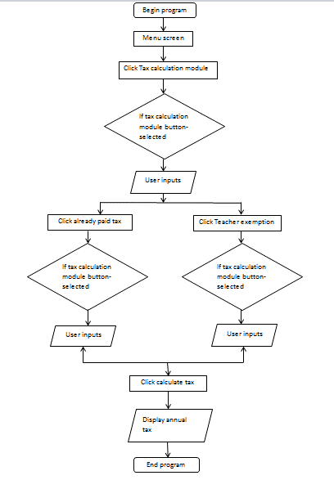
UI INTERFACE REPRESENTATION

Slide 9
WORKING INTERFACE
1. User-Friendly Design: The interface should be intuitive and easy to navigate, allowing users to access different components of the research process seamlessly.
2. Clear Navigation: Clearly labeled sections or tabs for each component (e.g., problem identification, literature review, methodology) enable users to move between different stages of the research process efficiently.
3. Visual Representation: Incorporating visual elements such as flowcharts, diagrams, or timelines can help users visualize the sequential flow of the research process and understand the relationships between different components.
4. Interactive Features: Interactive features such as drop-down menus, checkboxes, or sliders can enhance user engagement by allowing them to customize their research parameters or preferences within the interface.

Slide 10
EXISTING SYSTEM
The existing system typically consists of separate tools and platforms for each component of the research process, such as problem identification, literature review, methodology development, data collection, analysis, and interpretation. Researchers often rely on a combination of software applications, online databases, and manual methods to conduct their research.
This fragmented approach can lead to inefficiencies, inconsistencies, and challenges in managing the research process effectively. Additionally, collaboration and communication among researchers may be limited, leading to coordination issues and potential duplication of efforts.

Slide 11
PROPOSED SYSTEM
1. Gather Tax Rates and Brackets: Research and gather accurate tax rates and brackets for the relevant tax year. This includes federal, state, and local tax rates if applicable.
2. Understand Taxable Income: Understand what constitutes taxable income, including wages, interest, dividends, capital gains, and other sources of income. Consider deductions and credits that can reduce taxable income.
3. Consider Filing Status: Incorporate options for different filing statuses such as single, married filing jointly, married filing separately, and head of household. Each status has different tax brackets and deductions.
4. Incorporate Deductions and Credits: Include standard deductions or itemized deductions as well as tax credits, as these significantly impact the final tax amount.

Slide 12
ADVANTAGES
Efficiency
Consistency
Collaboration
Customization
Automation
Data Security
Scalability
User Support

Slide 13
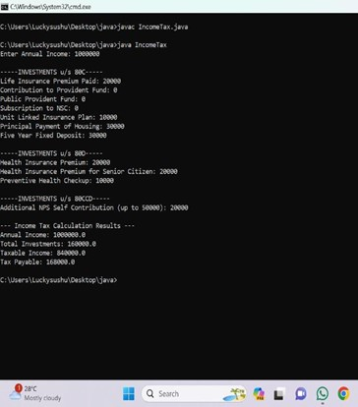
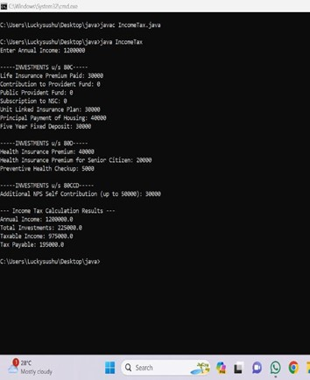
OUTPUT

Slide 14
FUTURE ENHANCEMENT
Advanced Analytics Integration: Enhance the system with advanced analytics capabilities such as predictive modeling, clustering, and sentiment analysis to extract deeper insights from research data.
Machine Learning Capabilities: Implement machine learning algorithms to automate repetitive tasks, improve data analysis accuracy, and uncover patterns or trends in research data.
Enhanced Visualization Tools: Develop interactive and customizable visualization tools to present research findings in a visually engaging and comprehensible manner, facilitating data interpretation and communication.
Artificial Intelligence Assistance: Incorporate artificial intelligence assistants to provide personalized recommendations, automate routine tasks, and assist researchers in navigating the research process more efficiently.

Slide 15
CONCLUSION
In conclusion, the development and implementation of the income tax calculator project have been successful in achieving its objectives.
The project aimed to provide users with a user-friendly tool to calculate their income tax liability accurately and efficiently.
Through thorough research, analysis, and programming, we have created a robust application that considers various tax brackets, deductions, and credits to provide users with precise results.
The user interface has been designed to be intuitive, allowing users to input their financial information easily.
The algorithm behind the calculator takes into account the latest tax regulations and ensures compliance with tax laws.

Slide 16


